Slide 1
Hyperplane based Classifiers (1): The Perceptron Algorithm
CS771: Introduction to Machine Learning
Piyush Rai

Slide 2
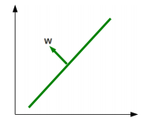
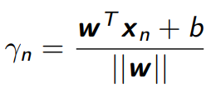
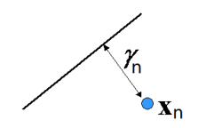
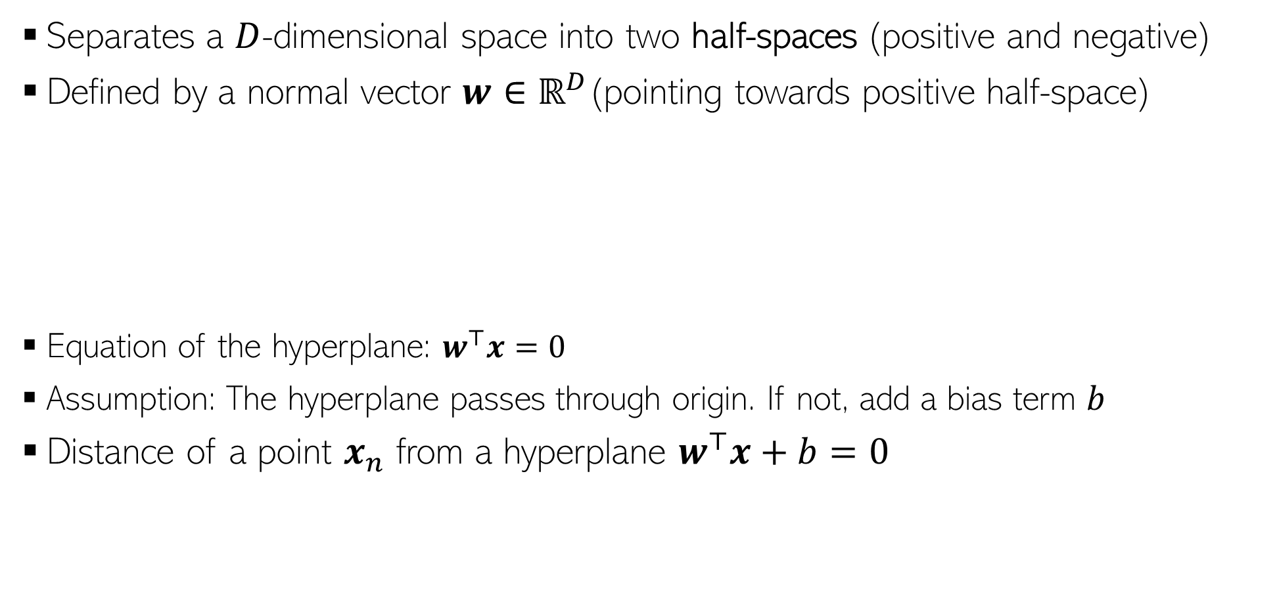
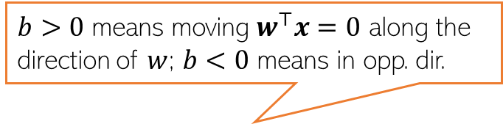
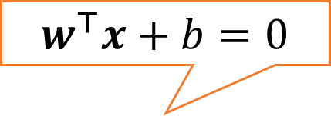
Hyperplane
Separates a $D$-dimensional space into two half-spaces (positive and negative)
Defined by a normal vector $w∈ℝ^{D}$(pointing towards positive half-space)
Equation of the hyperplane: $w^{⊤}x=0$
Assumption: The hyperplane passes through origin. If not, add a bias term $b$
Distance of a point $x_{n}$ from a hyperplane $w^{⊤}x+b=0$
$b>0$ means moving $w^{⊤}x=0$ along the direction of $w$; $b<0$ means in opp. dir.
$$w^{⊤}x+b=0$$
Can be positive or negative

Slide 3

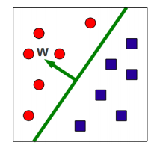
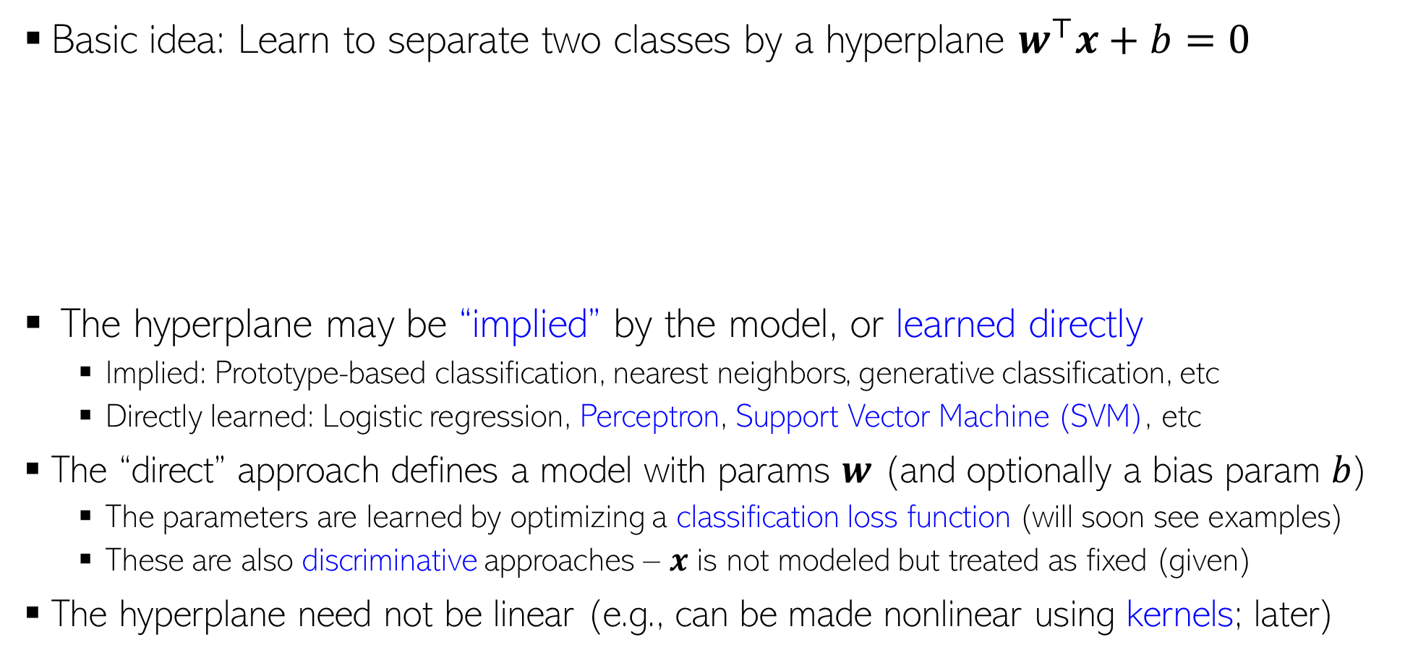

Hyperplane based (binary) classification
Basic idea: Learn to separate two classes by a hyperplane $w^{⊤}x+b=0$
The hyperplane may be “implied” by the model, or learned directly
Implied: Prototype-based classification, nearest neighbors, generative classification, etc
Directly learned: Logistic regression, Perceptron, Support Vector Machine (SVM), etc
The “direct” approach defines a model with params $w$ (and optionally a bias param $b$)
The parameters are learned by optimizing a classification loss function (will soon see examples)
These are also discriminative approaches – $x$ is not modeled but treated as fixed (given)
The hyperplane need not be linear (e.g., can be made nonlinear using kernels; later)
For multi-class classification with hyperplanes, there will be multiple hyperplanes (e.g., one for each pair of classes); more on this later
Prediction Rule
$$y_{∗}= {sign(w}^{⊤}x_{∗}+b)$$

Slide 4
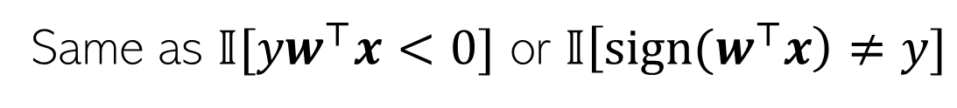
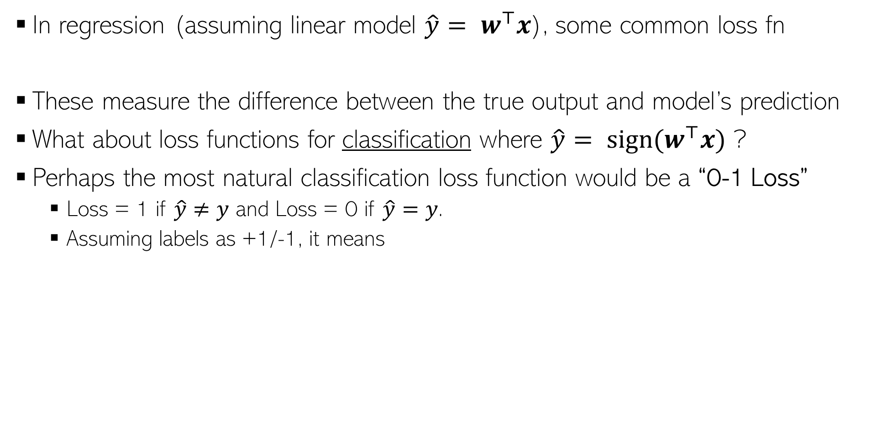

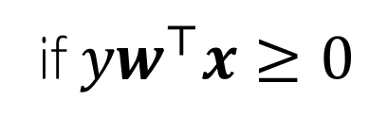
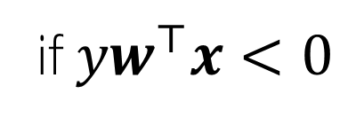



Interlude: Loss Functions for Classification
In regression (assuming linear model ${\hat{y}= w}^{⊤}x$), some common loss fn
These measure the difference between the true output and model’s prediction
What about loss functions for classification where ${\hat{y}= sign(w}^{⊤}x)$ ?
Perhaps the most natural classification loss function would be a “0-1 Loss”
Loss = 1 if $\hat{y}≠y$ and Loss = 0 if $\hat{y}=y$.
Assuming labels as +1/-1, it means
$ℓ(y,$ $\hat{y})={\left(y− \hat{y}\right)}^{2}$
$ℓ(y,$ $\hat{y})=\left|y− \hat{y}\right|$
0-1 Loss
Non-convex, non-differentiable, and NP-Hard to optimize (also no useful gradient info for the most part)
$$ℓ(y, \hat{y})=\left\{\begin{aligned}1 \\ 0\end{aligned}\right.$$
if ${yw}^{⊤}x<0$
if ${yw}^{⊤}x≥0$
(0,1)
Same as $𝕀[{yw}^{⊤}x<0]$ or $𝕀\left[{sign(w}^{⊤}x\right)≠y]$
(0,0)
$${yw}^{⊤}x$$

Slide 5

Interlude: Loss Functions for Classification
An ideal loss function for classification should be such that
Loss is small/zero if $y$ and $sign(w^{⊤}x)$match
Loss is large/non-zero if $y$ and $sign(w^{⊤}x)$do not match
Large positive ${yw}^{⊤}x$⇒ small/zero loss
Large negative ${yw}^{⊤}x$⇒ large/non-zero loss
“Perceptron” Loss
Convex and Non-differentiable
Already saw this in logistic regression (the likelihood resulted in this loss function)
Log(istic) Loss
Hinge Loss
(0,0)
(0,1)
Convex and Differentiable
Convex and Non-differentiable
(0,0)
(0,0)
(1,0)

Slide 6
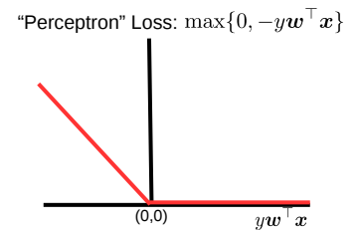
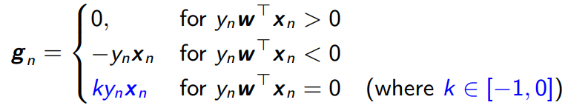

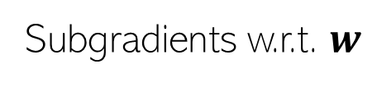
Learning by Optimizing Perceptron Loss
Let’s ignore the bias term $b$ for now. So the hyperplane is simply $w^{⊤}x=0$
The Perceptron loss function: $L\left(w\right)= \sum_{n=1}^{N}{max\{0,−y_{n}w^{⊤}x_{n}\}}$. Let’s do SGD
If we use $k = 0$then $g_{n}=0$ for $y_{n}w^{⊤}x_{n}≥0$, and $g_{n}={−y}_{n}x_{n}$ for $y_{n}w^{⊤}x_{n}<0$
Non-zero gradients only when the model makes a mistake on current example $(x_{n}, y_{n})$
Thus SGD will update $w$ only when there is a mistake (mistake-driven learning)
Subgradients w.r.t. $w$
One randomly chosen example in each iteration

Slide 7
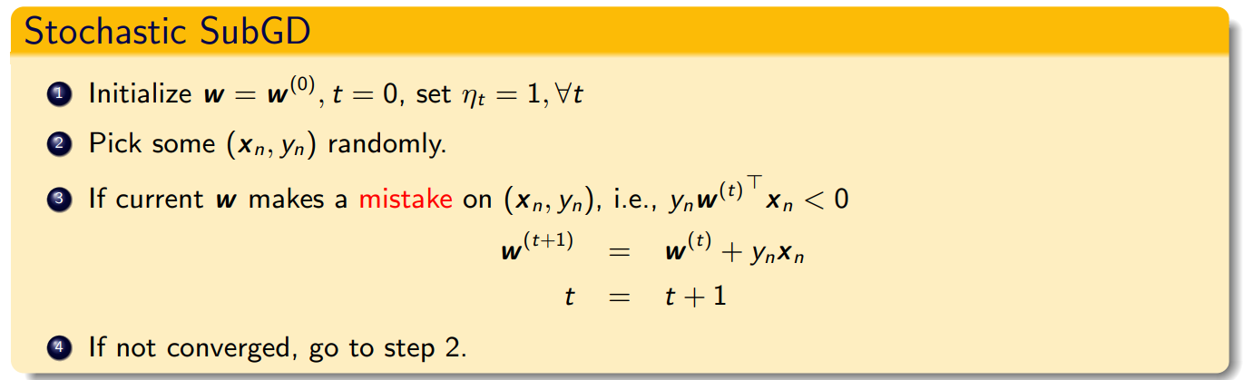
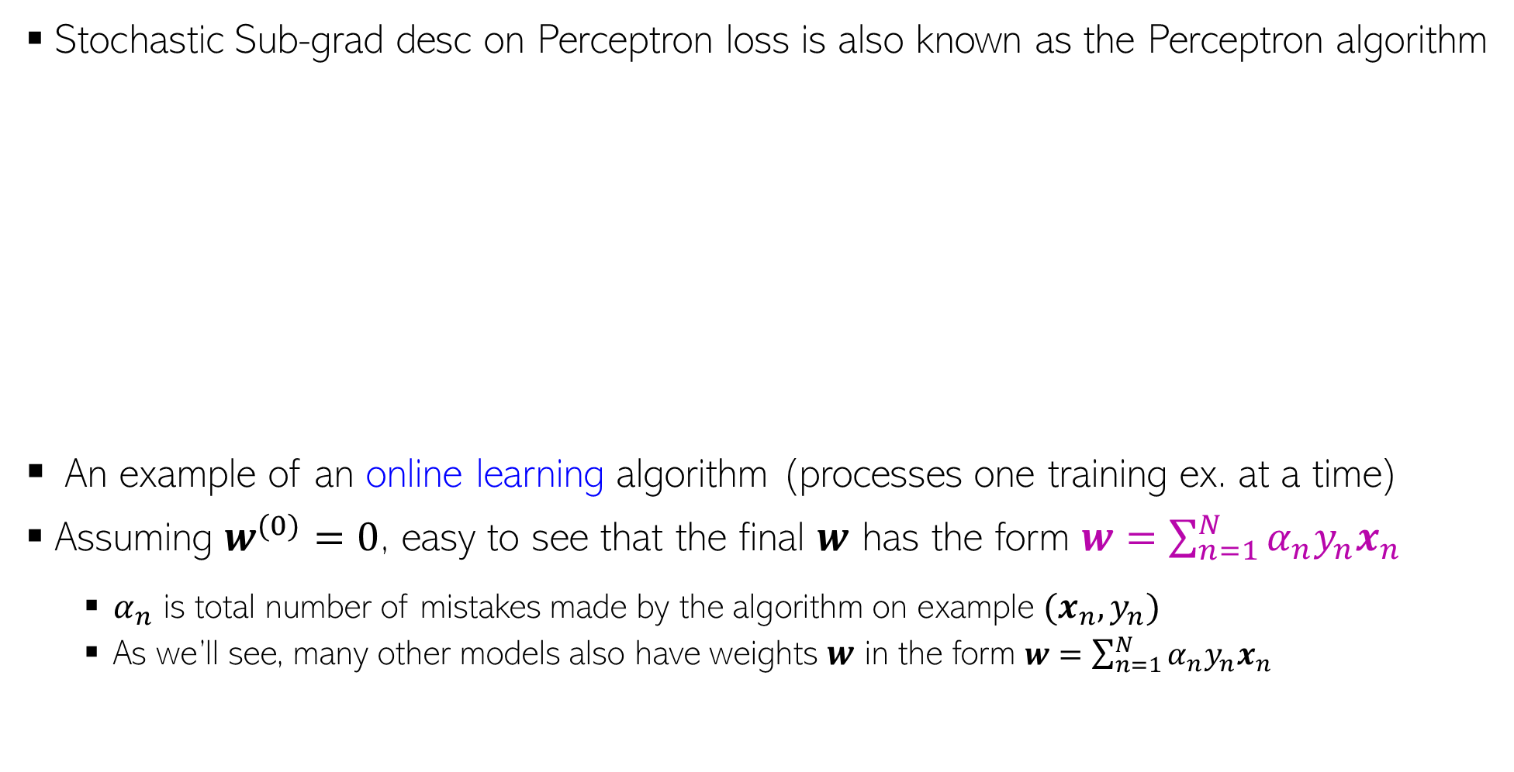

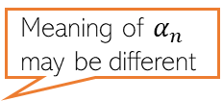
The Perceptron Algorithm
Stochastic Sub-grad desc on Perceptron loss is also known as the Perceptron algorithm
An example of an online learning algorithm (processes one training ex. at a time)
Assuming $w^{(0)}=0$, easy to see that the final $w$ has the form $w=\sum_{n=1}^{N}{α_{n}y_{n}x_{n}}$
$α_{n}$ is total number of mistakes made by the algorithm on example $(x_{n}, y_{n})$
As we’ll see, many other models also have weights $w$ in the form $w=\sum_{n=1}^{N}{α_{n}y_{n}x_{n}}$
Updates are “corrective”: If $y_n = +1$ and $w^{⊤}x_{n}<0$, after the update $w^{⊤}x_{n}$ will be less negative. Likewise, if $y_{n}=−1$ and $w^{⊤}x_{n}>0$, after the update $w^{⊤}x_{n}$ will be less positive
Note: An example may get chosen several times during the entire run
Mistake condition
If training data is linearly separable, the Perceptron algo will converge in a finite number of iterations
(Block & Novikoff theorem)
Meaning of $α_{n}$ may be different

Slide 8
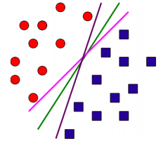
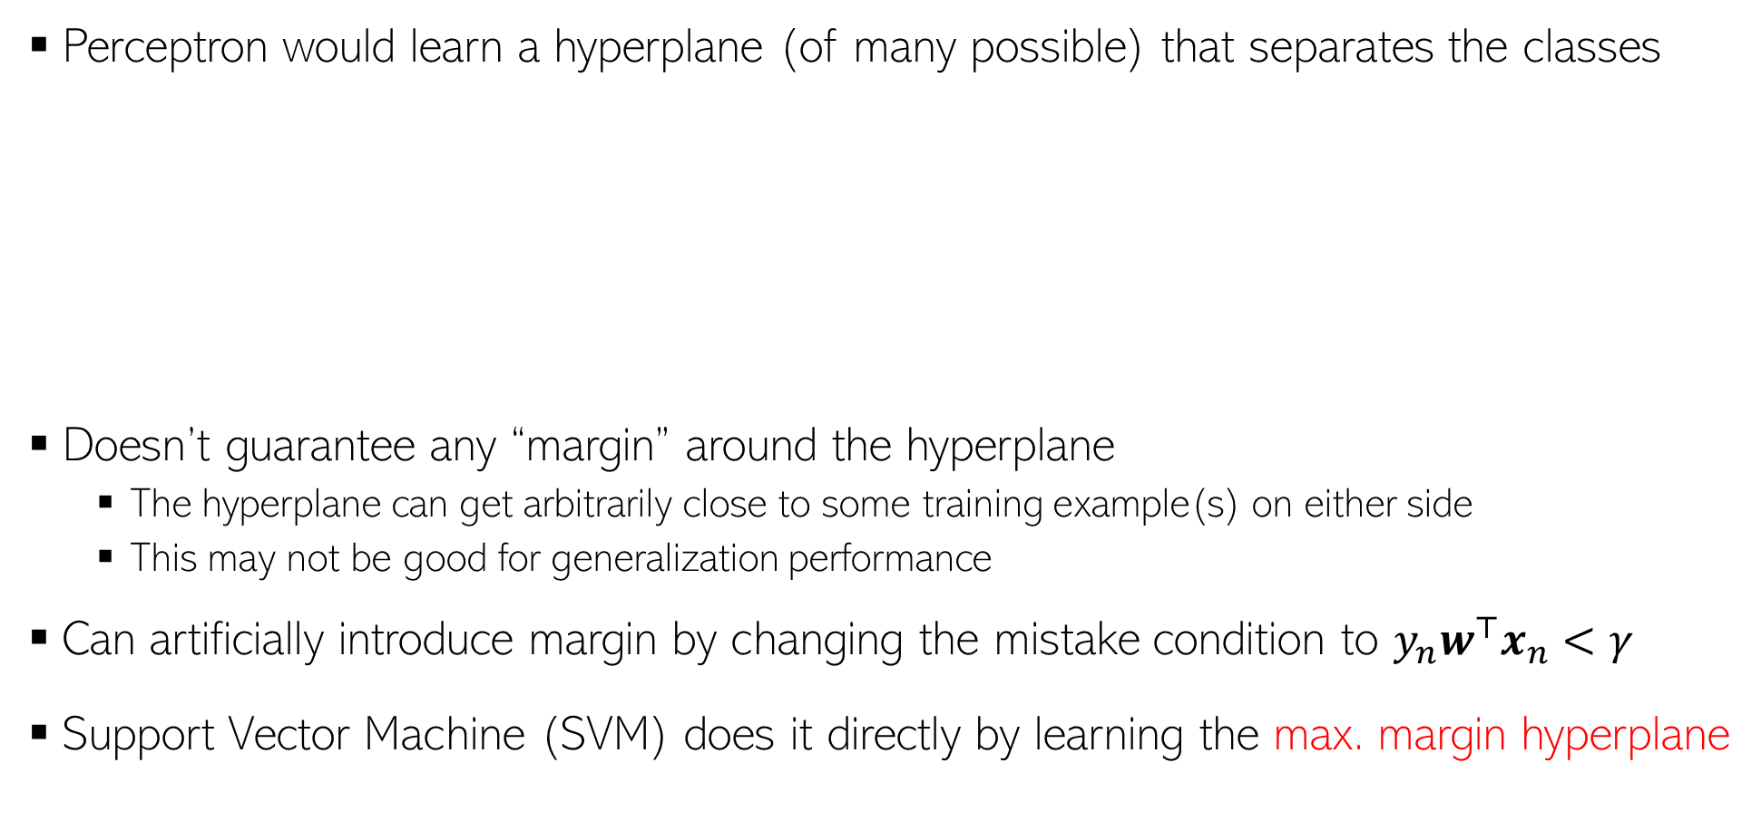

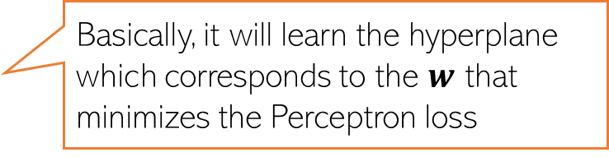
Perceptron and (lack of) Margins
Perceptron would learn a hyperplane (of many possible) that separates the classes
Doesn’t guarantee any “margin” around the hyperplane
The hyperplane can get arbitrarily close to some training example(s) on either side
This may not be good for generalization performance
Can artificially introduce margin by changing the mistake condition to $y_{n}w^{⊤}x_{n}<γ$
Support Vector Machine (SVM) does it directly by learning the max. margin hyperplane
Basically, it will learn the hyperplane which corresponds to the $w$ that minimizes the Perceptron loss
Kind of an “unsafe” situation to have – ideally would like it to be reasonably away from closest training examples from either class
$γ>0$ is some pre-specified margin

Slide 9
Coming up next
Support Vector Machines

